Slide 1
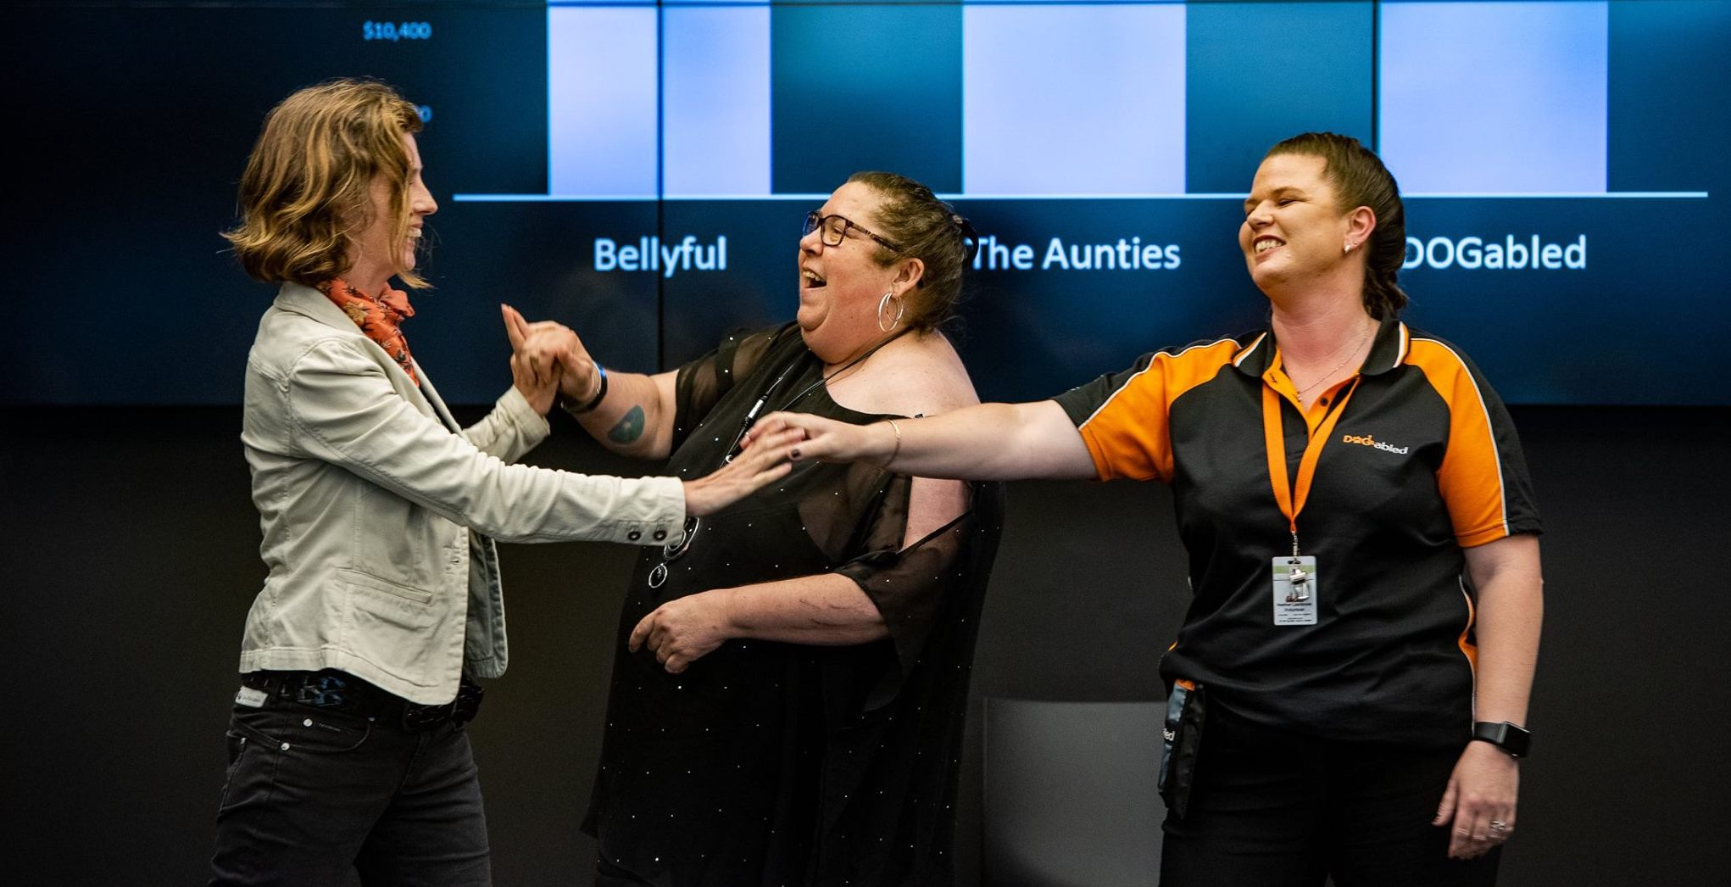
How to create your perfect pitch
Inspiring the little contributions,
that together, facilitate big change
Notes:
Tēnā koutou e te whanua
Pepeha

Slide 2
Tim Pare
CEO – The Funding Network NZ
Pitch coaching and crowdfunding
Next applications open June 28th
In Your Corner
Strategy and fundraising for the small charity sector
Edmund Hillary Fellowship
Founded two charities
Raised over $5 million

Slide 3
Today
What makes a good pitch?
The 5 Ps
Storytelling
Structuring your pitch

Slide 4
What makes a good or bad pitch?
Bad | Good
Unclear with multiple messages | Passionate
Read a script / too much jargon | Logical argument
Insincere / Unbelievable | Clear call to action / ask
Rambling and confusing | Authenticity
Monotonous / self-centred | Vulnerability
Fidgeting and nervous | Funny
Bad use of PowerPoint | Stage presence
Too long, too short, too fast, too slow | Good use of pictures or video
No call to action | Persuasive data
Too much or no data | Modesty
Don’t connect with audience | Storytelling
Locked to the lectern | Good structure and signposting
Notes:
Write up on flip chart, get to shout out

Slide 5
The Five Ps Framework
There are five key fundamentals to creating the perfect pitch:
1. Passion
2. Purpose
3. Planning
4. Practice
5. Performance

Slide 6
Passion – The Neuroscience of Persuasion
“Culture eats strategy for breakfast”
Peter Drucker
People fund people, not programmes
Notes:
Emotion drives behaviour. Rationality can help us arrive at conclusions, come to a decision or justify a set of actions.
But only by moving the emotions are we able to inspire action.

Slide 7
How much of communication is non-verbal?
Multiple research studies since 1970s suggest in excess of 50%:
10% Words
25% Tone of Voice
65% Body language
Notes:
The audience will only remember a few things you say, but it is the passion that will create an emotional connection, and it is that emotional connection that will determine whether the audience acts on your words or not.

Slide 8
What is your ‘why’?
“People don’t buy what you do; they buy why you do it”
Simon Sinek
Your ‘why’ is your clearest articulation of your purpose in life. Your brand essence. In this type of work, it’s the thing that drives people to do the work they do.
This must come through in your pitch. Both your purpose and the purpose of your organisation.

Slide 9
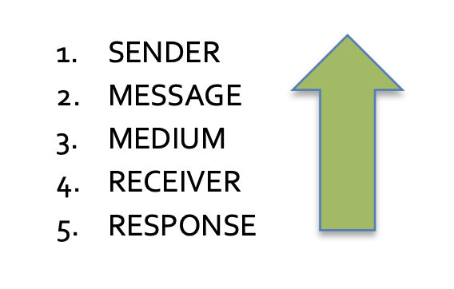
The Art of Response Management:
From Theory to Practice.
Notes:
The simple statement “What am I going to say”? encapsulates everyone’s most common mistake. i.e. most people start at the top with themselves, the Sender, and work their way down towards their intended outcome, the Response.
Most successful communication is a bottom up planning process. It starts with considering WHO the audience is, what kind of response you want from them and ultimately what you want them to do. Only once you are clear on that, should you move back up to reconsider the medium, the main message and even the sender. Often this will inspire you to reconsider the message, it’s content and even who is the best person to deliver it.
First, you should gather as much knowledge and insight into your audience as you can: attitudes, feelings, biases, behaviours, context, relationships, common knowledge. Anything you can find out will give you an edge. And this shouldn’t stop when you actually pitch. Every pitch is a conversation. Make sure you are on receive as well as transmit, this will help you to pick up on what the audience is thinking and make them feel that this is a two-way conversation.

Slide 10
Creating the Response You Want
What do you want the audience to:
NOTICE? their Sensory response to your body language
THINK? their Rational response to your words
FEEL? their Emotional response to your stories
DO? their Active response to your ask or call to action.
Notes:
They are thinking: Are you passionate, invested or just here because you get paid
Does it make sense, can I see how the solution works to address the problem?
Empathetic, concerned, incensed
Share the post, donate money, join the rally, become a volunteer

Slide 11
The Role of Storytelling
“The most powerful person in the world is the storyteller. The storyteller sets the vision, values and agenda of an entire generation that is to come.” Steve Jobs
Storytelling is the oldest human technique for conveying information and helps connect with people
It’s so much easier to retain information if it’s been captured in a story, rather than in data or bullet points
Usually, a single story about a beneficiary of your work or your own personal story about what inspired you will play a central role in your pitch
Stories create strong emotional connection and move people from consideration into action
If you can, take someone who has benefitted from your work with you

Slide 12
Tips for Good Storytelling
Here are a few tips:
Can be inserted at beginning, middle or end of pitch
Capture the audience’s attention and pull them in immediately
Use language that creates imagery, describes emotions and engages the senses
Share the detail: what, who, where, when, how, how many
Use real names and places (maybe changed to protect privacy)

Slide 13
Tips for Good Storytelling
There is a common structure or ‘arc’ for all stories:
Protagonist: the lead role (can be a person or an organisation)
Challenge: the obstacle or issue that the protagonist has to overcome
Transformation: the change or learning experience for the protagonist
Resolution: the final outcome

Slide 14
Practice
Public speaking experts advise that if you want to sound spontaneous, then practice more, not less.
Some tips:
Write up long hand, learn it, then bullet points
Practice your pitch in the mirror, video yourself, record it on phone and listen before you sleep
Pitch to the cat, dog, in the car – to anyone who will listen
Time your pitch, remember it takes longer in a live-pitch situation
The fewer the words, the more time it gives you for performance, pauses and creating emphasis
Notes:
Familiarity and confidence allow presenters to relax, tell better stories, react to the audience and answer questions more articulately and sound more spontaneous

Slide 15
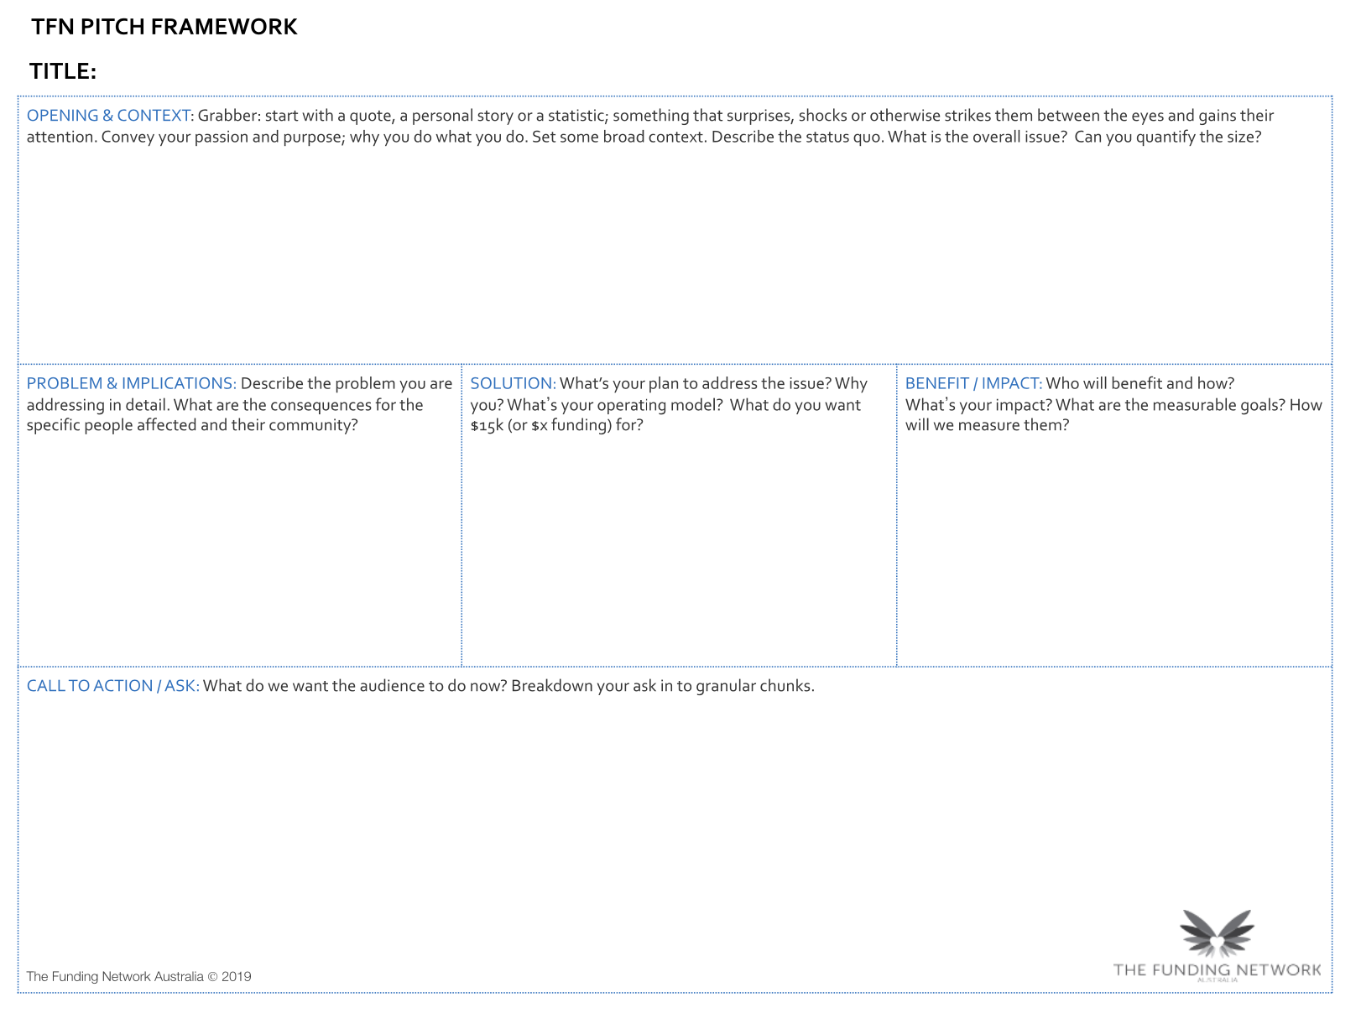
Notes:
Opening and Context – 1 min – grab, hook and credibility
Problem and Implications – 30 seconds – spend half as much time on the problem as the solution – optimism and positivity sells
Solution – 1 min
Benefit / Impact – 1 min
Call to Action / Ask -30 seconds
Case Study / Story – 1 min

Slide 16
Contact
Tim Pare
CEO
0211998077
info@thefundingnetwork.org.nz

