Slide 1
Benefits of Diversity by Anjum Rahman

Slide 2
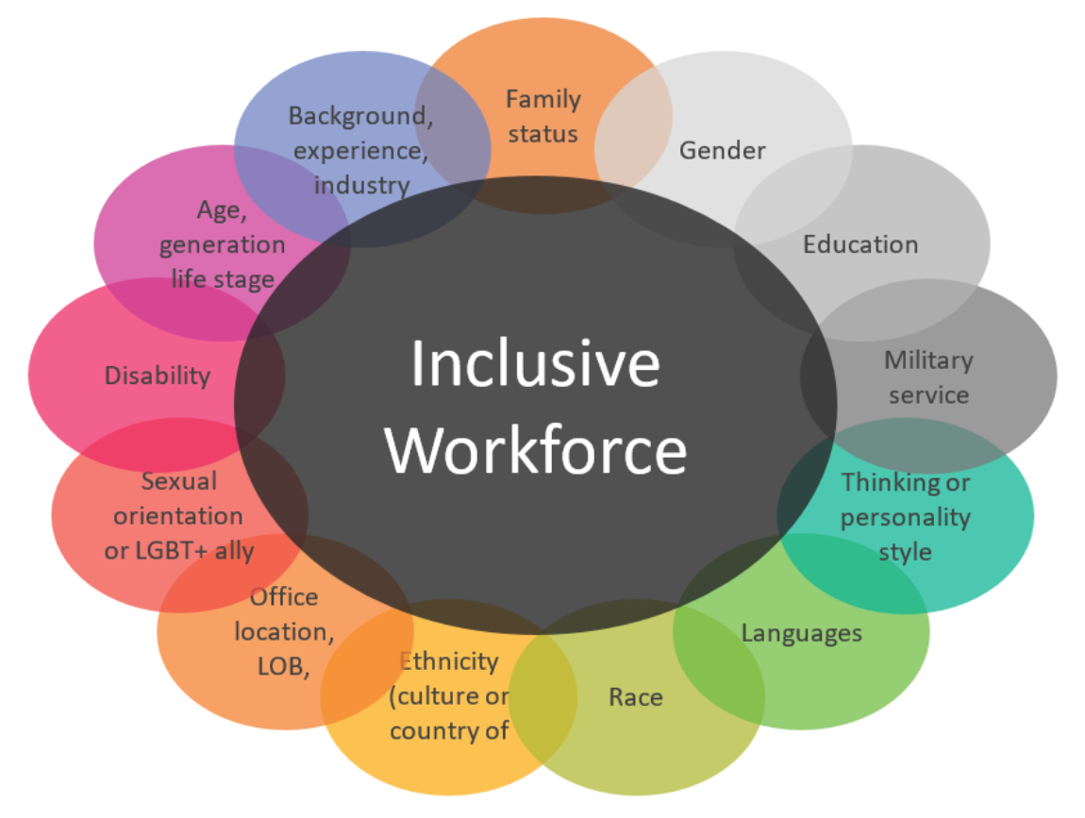
Economic Benefits
Improved productivity
Improved creativity
Increased profits
Improved employee engagement
Reduced employee turnover
Improved company reputation
Wider range of skills
Improves cultural insights and reduces discrimination
https://inside.6q.io/benefits-of-cultural-diversity-in-the-workplace/

Slide 3
Tangible and intangible benefits
New perspectives: diverse teams see a 60% improvement in decision-making abilities
Wider talent pool: diverse companies are more likely to attract the best talent
More innovation: companies that score well on indicators of diversity tend to be demonstrably more innovative
Better employee performance: a strong, homogeneous culture can stifle natural cognitive diversity due to the pressure to conform
Increased profits: those in the top quartile for ethnic and racial diversity in management were 35% more likely to have financial returns above their industry mean; U.S. public companies with diverse executive boards have a 95% higher return on equity
https://www.cultureamp.com/blog/benefits-of-diversity-in-the-workplace/

Slide 4
Advantages of Diversity
Increase reach: eg 1.1million people are disabled, according to Ministry of Health. Employing disabled individuals provides a powerful resource within your organisation that can help you reach this population
Reduce employee turnover: Deloitte University study reports that 83% of millennials are actively engaged when they believe their organization fosters an inclusive culture, compared to only 60% otherwise
Organisation Culture: When we have a strong, homogenous culture, we stifle the natural cognitive diversity in groups through the pressure to conform (Harvard Business Review)
Compete globally: individuals with a variety of different cultural backgrounds can help you secure your place in the global marketplace
Customer Service: insight into cultural norms that will help you avoid a marketing blunder that could negatively impact your brand
Diverse talent: American Sociological Association found that “companies reporting the highest levels of racial diversity brought in nearly 15 times more sales revenue on average
https://diverserecruitingexperts.com/benefits-diversity-in-workplace/

Slide 5
Social benefits: super-diversity
moving beyond a certain diversity threshold in the team can positively impact all group members by allowing them equal opportunity to influence team dynamics and group behaviour
residents in super-diverse neighbourhoods cannot simply categorise strangers into one of two camps—their own or the ‘other’
The density of differences in relation to age, gender, ethnicity, national background, culture, language, educational background, work experience, or time in [the country] or at the organisation, is simply too vast. They are too diverse to be prejudiced.
a high degree of differences impelled team members to engage in unilateral flows of assistance ensuring fairness and an equal share of work among all team members
contact and interaction with people of a different background is known to decrease stereotyping and discrimination
https://sciencenordic.com/culture-denmark-forskerzonen/diversity-leads-to-greater-social-coherence-and-well-being/1454678

Slide 6
The Institute of Economic Affairs pushes for the idea of pluralism which goes beyond viewing diversity as mere numerical representation of certain groups, to deeper interaction and genuine engagement between diverse groups, resulting in greater understanding and appreciation of the existing differences in a group.
Diversity in leadership only begets more diversity in society and everyone feels included and represented.
https://women2.com/2019/05/30/diversity-in-leadership-and-its-impact-on-society-as-a-whole/

Slide 8
Facts don’t change people’s minds
Even after the evidence “for their beliefs has been totally refuted, people fail to make appropriate revisions in those beliefs”
Reason developed to resolve the problems posed by living in collaborative groups
confirmation bias: the tendency people have to embrace information that supports their beliefs and reject information that contradicts them. Why? Hypersociability.
People believe that they know way more than they actually do. What allows us to persist in this belief is other people.
We’re reluctant to acknowledge mistakes. The moment you belittle the mind for believing in something, you’ve lost the battle. At that point, the mind will dig in rather than give in.
When your beliefs are entwined with your identity, changing your mind means changing your identity
https://www.newyorker.com/magazine/2017/02/27/why-facts-dont-change-our-minds

Slide 9
Diversity as a right
Social responsibility: accountability to ourselves, others and society; a more comprehensive set of working objectives than just profit alone
Social license to operate: approval within local community and stake-holders; ongoing acceptance. It is granted by the community, has to be earned and maintained https://www.tandfonline.com/doi/full/10.1080/03036758.2016.1186702
SR is ‘top-down’ with issues identified by the organisation, while SLO is ‘bottom-up’ with issues identified by the community and stakeholders themselves
Diversity is a lived reality in our communities
Human rights approach: intrinsic value of human beings that gives them rights and responsibilities
Right to participation and representation (https://www.forbes.com/sites/nazbeheshti/2018/12/20/diversity-and-human-rights-in-the-workplace-an-opportunity-not-an-obligation/?sh=30910dba5b6c)

