Slide 1
Mental Health and Wellbeing
CoLiberate Mental Health First Response

Slide 2
Check In
Notes:
What does wellbeing mean to you?
If you’re having a bad day, what might that look or sound like to those around you?
If you’re having a good day, what might that look or sound like to those around you?

Slide 3
Mental Health is a continuum
Everyone has mental health and anyone can experience a mental health challenge

Slide 4
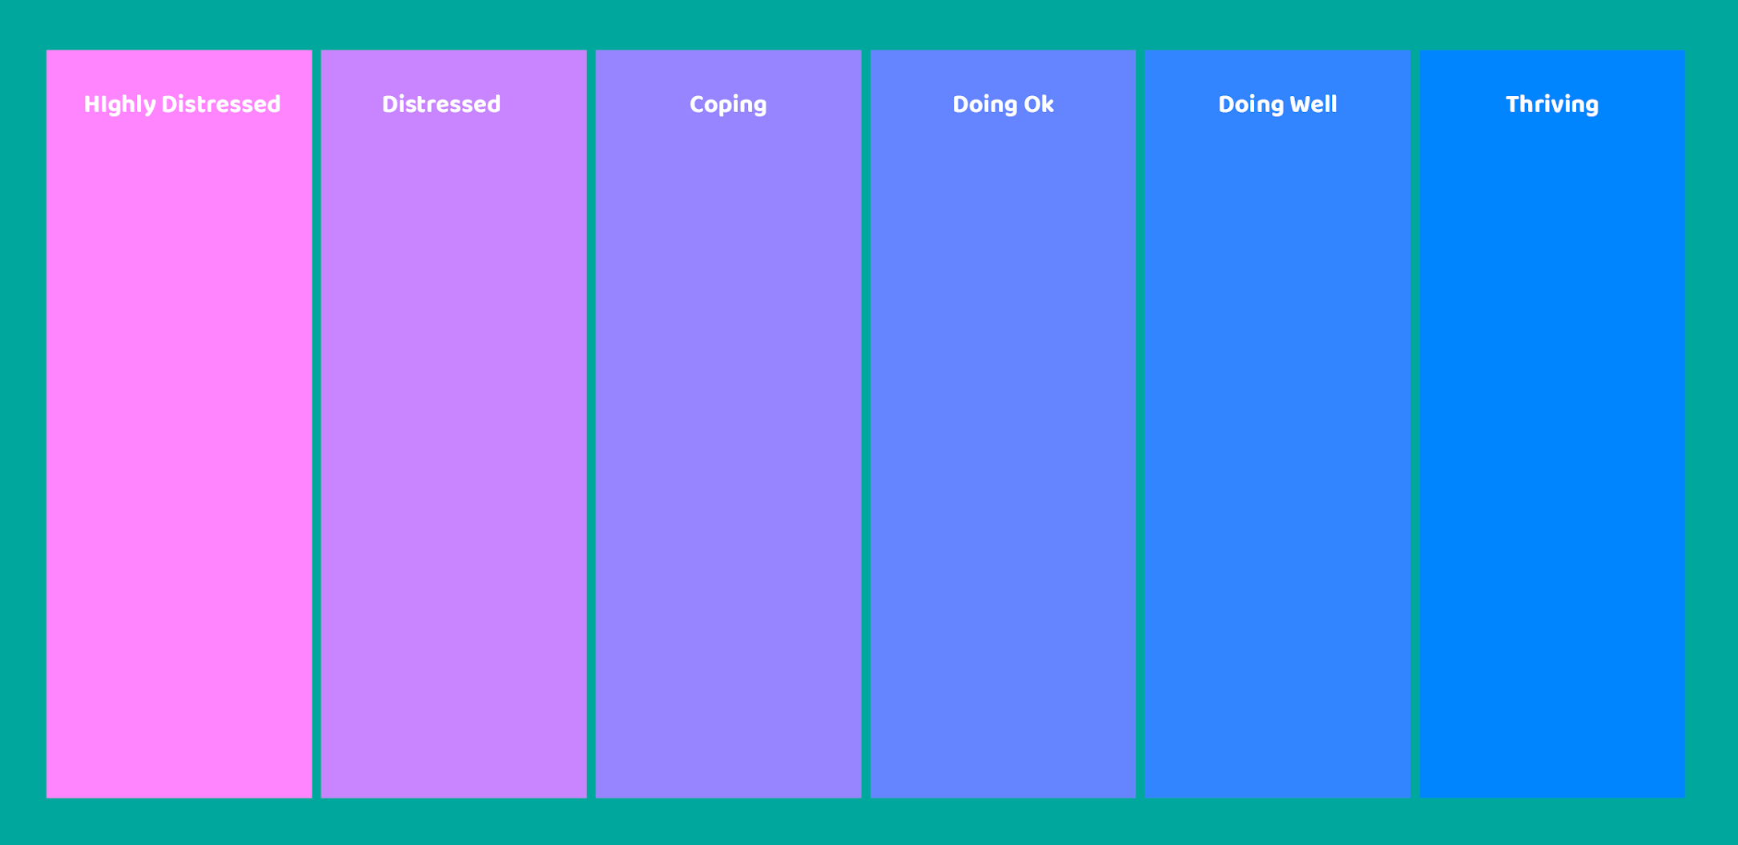
Mental Health Continuum

Slide 5
Notice Impact on Life
Notes:
What does wellbeing mean to you?
If you’re having a bad day, what might that look or sound like to those around you?
If you’re having a good day, what might that look or sound like to those around you?

Slide 6
Notice Impact on Life
A: “What is a chore you dislike, and how does that make you feel?”
Ask
Listen for feelings +impact
Reflect back feelings + impact
Check that your reflection is correct

Slide 7
Validate Feelings + Experiences
Notes:
What does wellbeing mean to you?
If you’re having a bad day, what might that look or sound like to those around you?
If you’re having a good day, what might that look or sound like to those around you?

Slide 8
Validate Feelings + Experiences
A: “What is a chore you dislike, and how does that make you feel?”
Ask
Listen for feelings +impact
Reflect back feelings + impact
Check that your reflection is correct
Validate feelings + impact

Slide 9
Types of Support
Notes:
What does wellbeing mean to you?
If you’re having a bad day, what might that look or sound like to those around you?
If you’re having a good day, what might that look or sound like to those around you?

Slide 10
Support Options: Professional
1. Helplines (e.g. 1737)
2. Employee Assistance Programmes [E.A.P.]
3. Counsellors / Therapists / Psychologists
4. General Practitioners / Doctors
5. Peer Support Services
6. Kaupapa Māori / Pasifika / Local Community Services

Slide 11
Support Options: Personal
“What do support options look like for you?”
“What do you do to fill your cup up?”
Could be… going for a run, a cup of tea, talking to your friend, meditation, prayer, mirimiri, creative writing, video games, peer support groups, sports teams...

Slide 12
Looking After Ourselves
Notes:
What does wellbeing mean to you?
If you’re having a bad day, what might that look or sound like to those around you?
If you’re having a good day, what might that look or sound like to those around you?

Slide 13
Self Support
How do we look after ourselves?
Referral is good MHFR if we don’t have time / capacity
Try to be only one of at least three supporters
Debrief with our own support networks
Our own Personal Supports list

Slide 14
Check Out
Notes:
What are you doing for self- care today?

Slide 15
It’s the little
convos that make
the biggest difference
twitter.com/coliberatenz @coliberateNZ
www.facebook.com/coliberate
@coliberate
linkedin.com/company/18340454 @coliberate
hello@coliberate.co.nz
coliberate.co.nz

Slide 16
Mental Health and Wellbeing
CoLiberate Mental Health First Response

